Slide 1
How does the CPU work?
When a program starts, CPU’s program counter (PC) register has address i of the first instruction (this is called the program entry point; the OS gets this address from the machine language program file stored on disk)
Control circuits “fetch” (read) the contents of the location at that address by sending the address to the memory so that it can read the instruction bit string and send it back to the CPU.
The instruction is then “decoded” ("split into parts" -more on this later) and executed
During execution of each instruction (after instruction’s address is sent to memory to fetch instruction), the PC register is incremented by 8 (for a 64 bit RISC architecture)
But *how* does this actually work? … it is a complicated but essential story …

Slide 2
Logic gates/circuits
At the lowest level, we have electronic circuits … but we won’t go down to that level
We will consider level of logic gates/circuits
Each logic circuit will have one or more input ports and (typically) one output port (although some have more than one output)
Before looking at logic gates, let us introduce the underlying math concepts

Slide 3
Boolean logic/algebra
Two values:
true/false
on/off
1/0
We commonly use 1/0 but the others are also very important
But most important of all: They all mean the same thing; everything we say about Boolean logic is true and works the same way whether the two values are true/false, on/off, or 1/0.

Slide 4
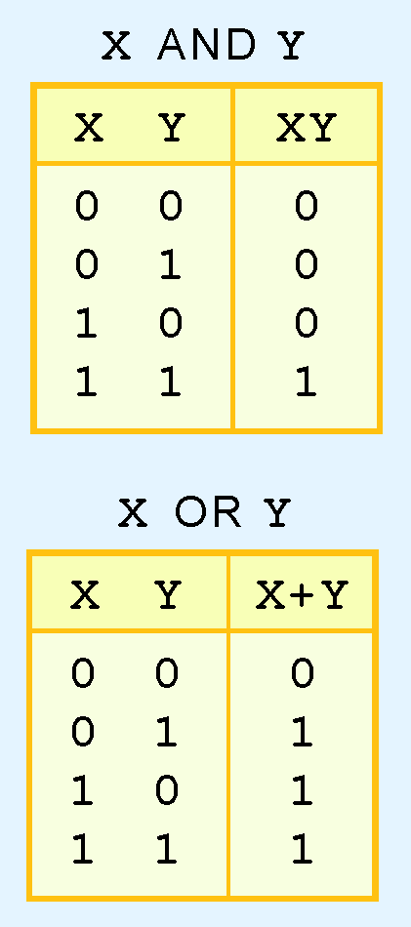
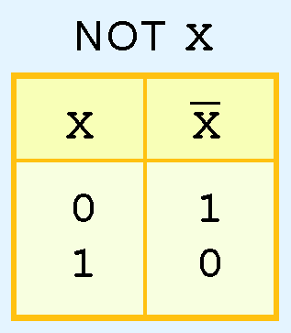
Boolean operations: AND, OR, NOT
A Boolean operator is defined using a truth table, which shows the gate output for given input(s)
AND is like product
OR is like sum; but 1+1 is not 2 (because 2 is not a Boolean value!)
NOT denoted by overbar or ~

Slide 5
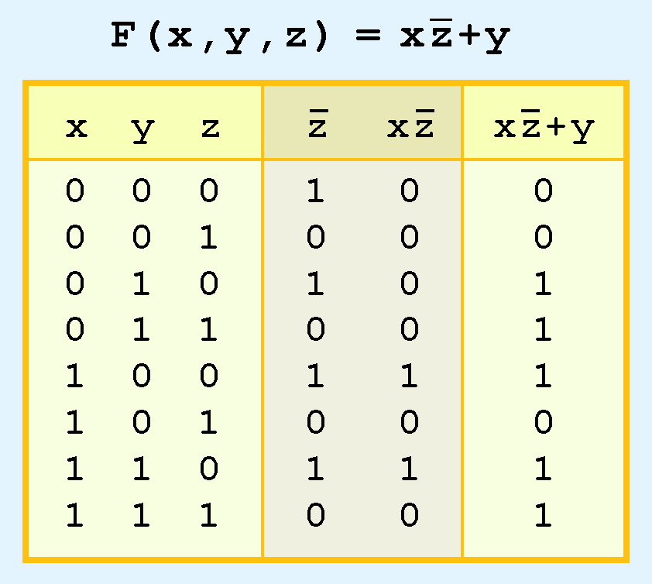
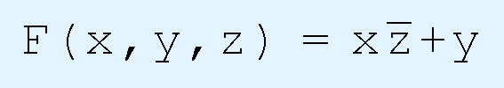
More complex boolean functions
Are built out of basic ones:
Precedence: NOT then AND then OR (“NAO Rule”)
So: F(x,y,z) = ((x( ͞͞z )) + y)
The parentheses show the precedence explicitly, but even without them, the precedence is known, according to the NAO rule given above.

Slide 6
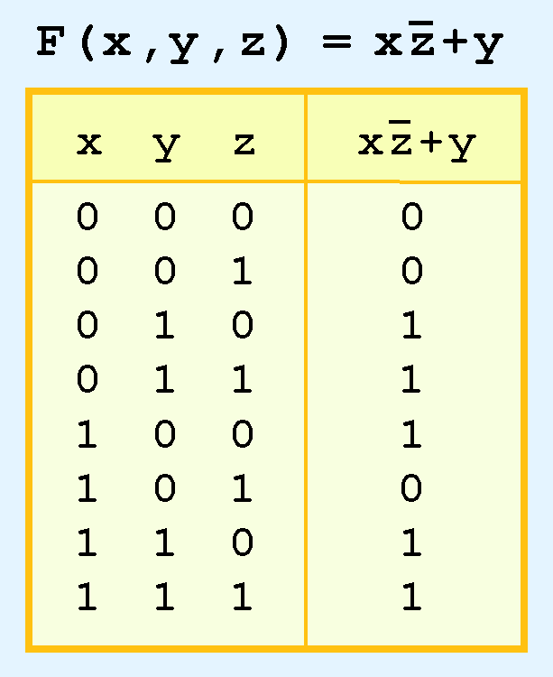
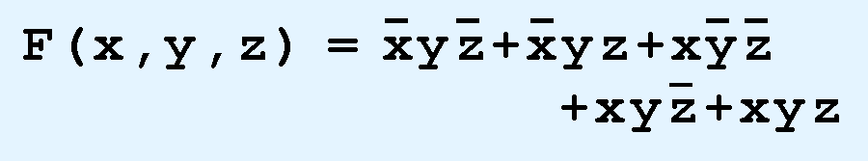
Complex functions as sum of products
For each “1” in result column, write corresponding product term; the sum of all the product terms is equal to the function:
But this is (usually) not the simplest form; can be simplified using various identities (rules) [See below.]
Notes:
Can also be written as product of sums: Consider each row with 0 result; it should *not* arise. So for first row, you get the term (x + y + z); for second row, (x + y + z’); for sixth row you get (x’ + y + z’). Product of these three is the result

Slide 7
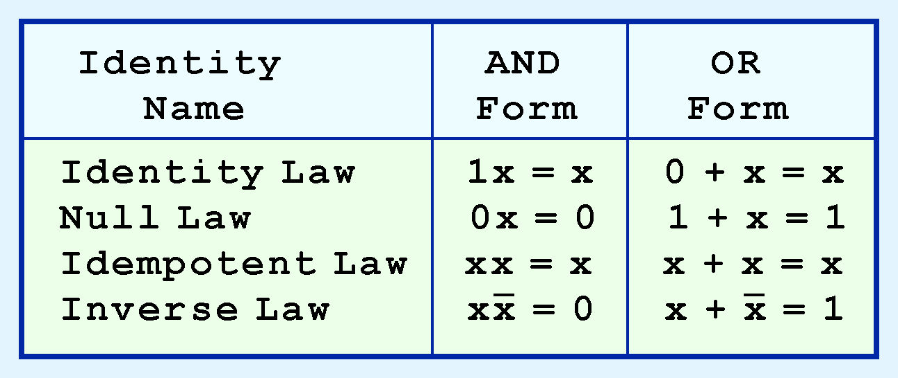
Useful identities/laws
These can be verified from the basic definitions (and the precedences of the operations − NOT then AND then OR (NAO))
Most laws/identitities have an AND form and an OR form

Slide 8
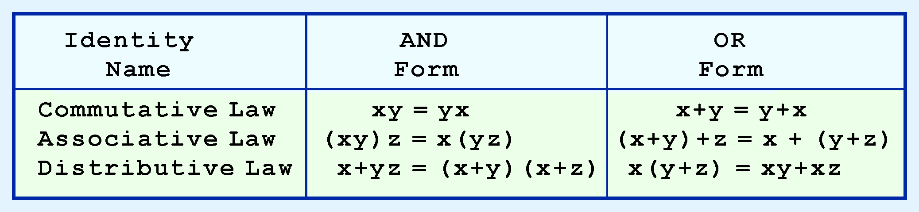
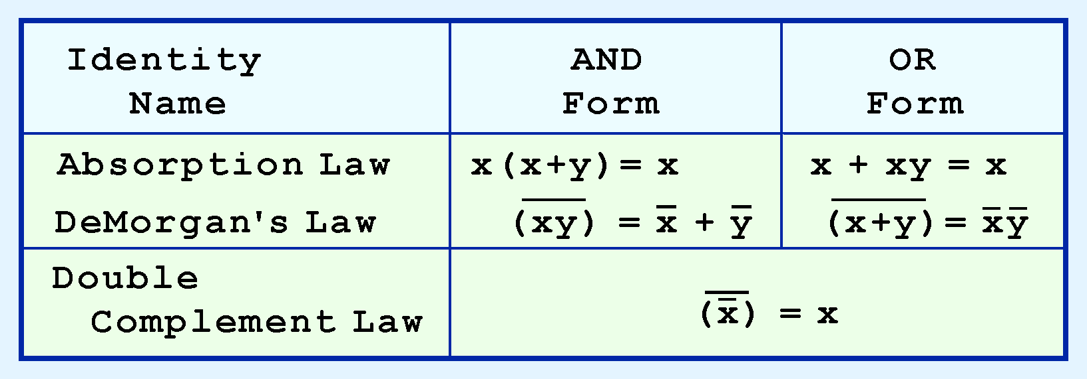
Useful identities/laws (contd)

Slide 9

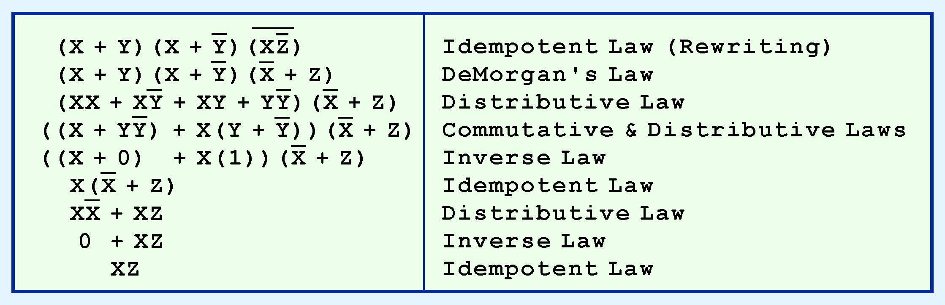
Laws can be used to simplify functions
Simplification is very important in practice because it can substantially reduce the cost(s) of circuits but nothing conceptually new.
Fact that every Boolean function can be written as a sum of products or product of sums (and then simplified) is fundamental.

Slide 10
Importance of Function Simplification
Using Boolean laws to simplify Boolean functions (and the circuits that implement them) is extremely important as a practical matter.
If a circuit is simpler (requires fewer gates-see below), then we can also say:
It will be cheaper to implement (since gates have a cost);
It will use less power, since each gate consumes power;
It will dissipate less heat (because it consumes less power), so it will be easier to cool.
These benefits with respect to production cost, power and heat have practical consequences for producing and using a computer system.

Slide 11
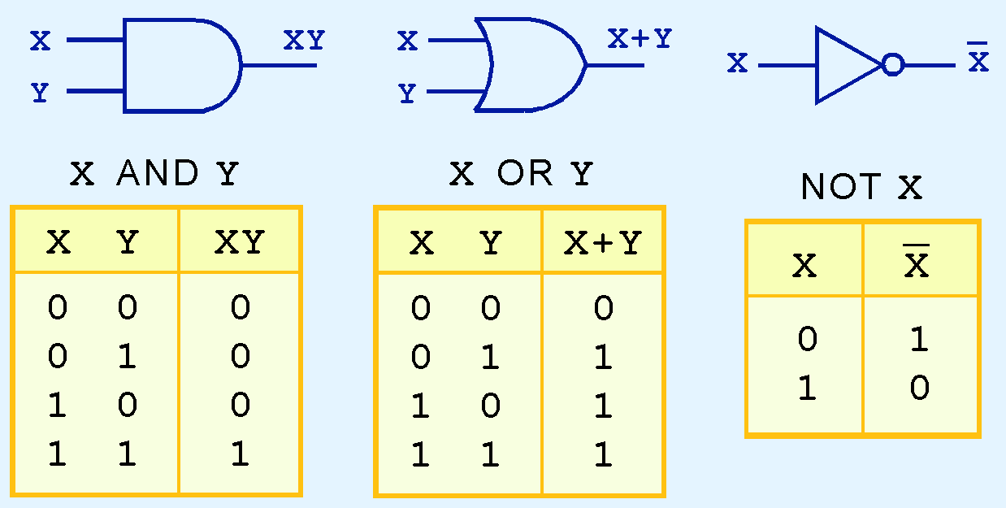
Logic Gates
The simplest logic gates: AND, OR, NOT

Slide 12
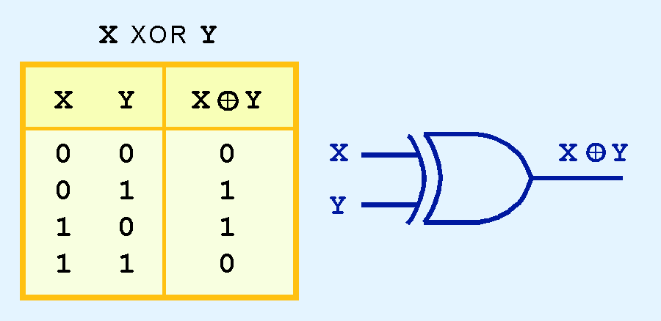
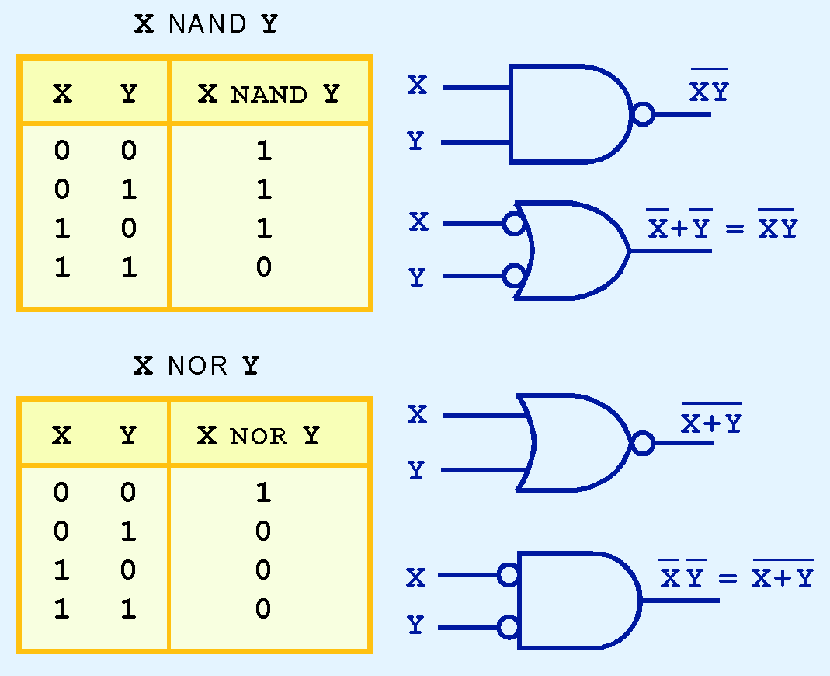
Logic Gates (contd)
3 other important gates: XOR, NAND, NOR
NAND, NOR are cheap to make
And they are universal: any function can be built using just NAND or just NOR

Slide 13
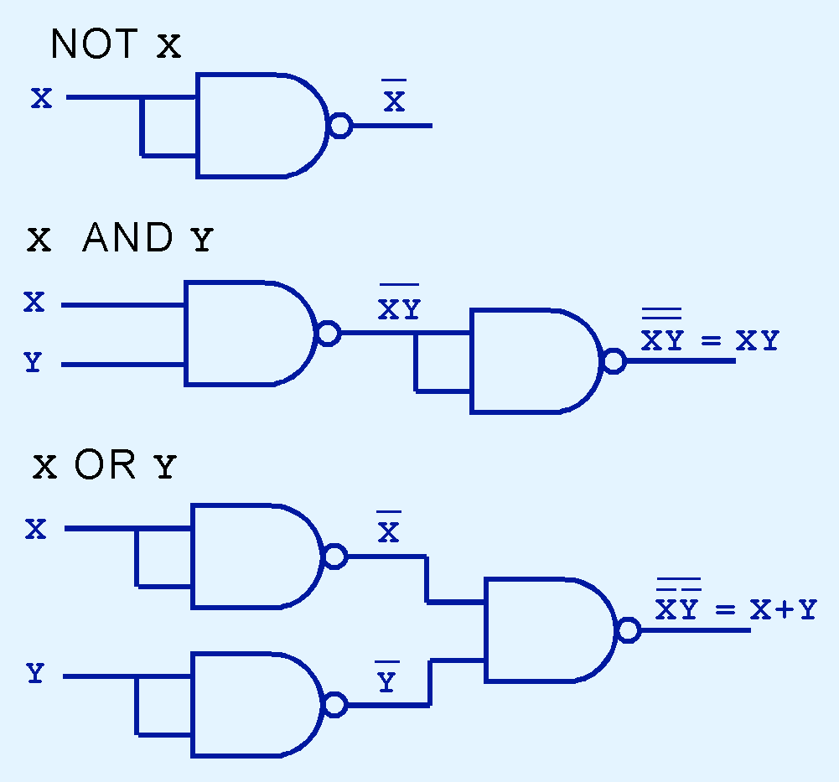
Logic Gates (contd.) – showing NAND is universal
NOT, AND, OR using NAND:

Slide 14

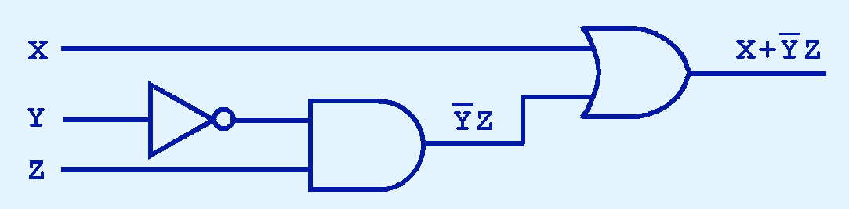
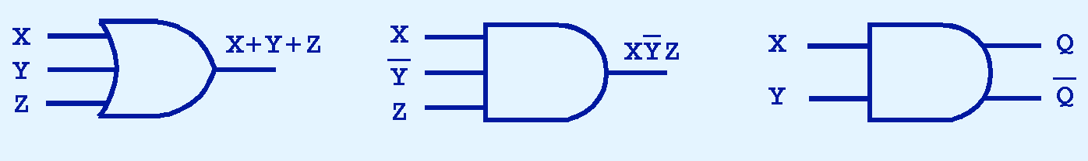
Logic gates used to implement functions
The main thing to remember: combinations of gates implement Boolean functions.
The circuit below implements the Boolean function (see NAO?):
Gates may have multiple inputs; & multiple outputs-- especially complement outputs, i.e, Q, ~Q

Slide 15
Logic gates/circuits (contd)
Some important principles:
The output of a circuit is connected to the input of one or more other circuits … but you cannot connect the output of a circuit to its own input [Short circuit!]
You cannot connect the output of a circuit to the output of another circuit, but rather, only to the input of another circuit
Each circuit has a slight delay (signals do not pass infinitely fast!) so that if one or more of its input signals changes, the output will stabilize to its new value after a very short delay; most of the time this can be ignored for our purposes (but designers of the system circuitry have to pay attention to it).

Slide 16
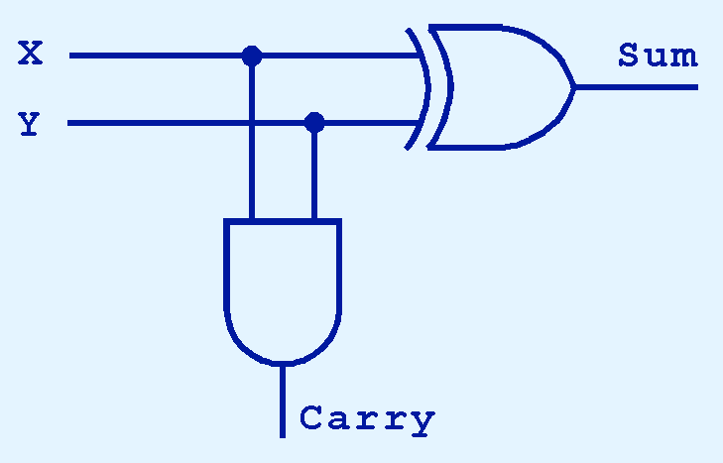
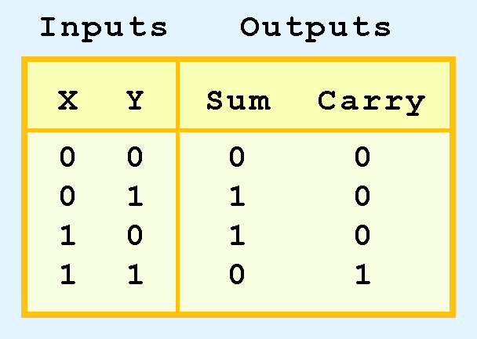
Half adder
The following is a “half adder”:
It is a half-adder because it doesn’t allow for a “carry-in” although it produces a “carry-out” (it can only add 2 bits)

Slide 17
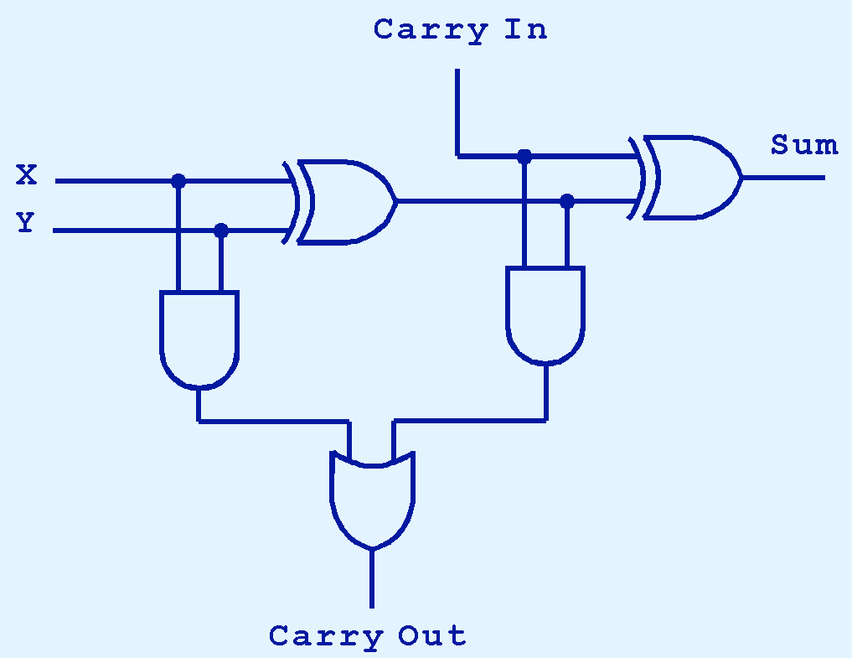
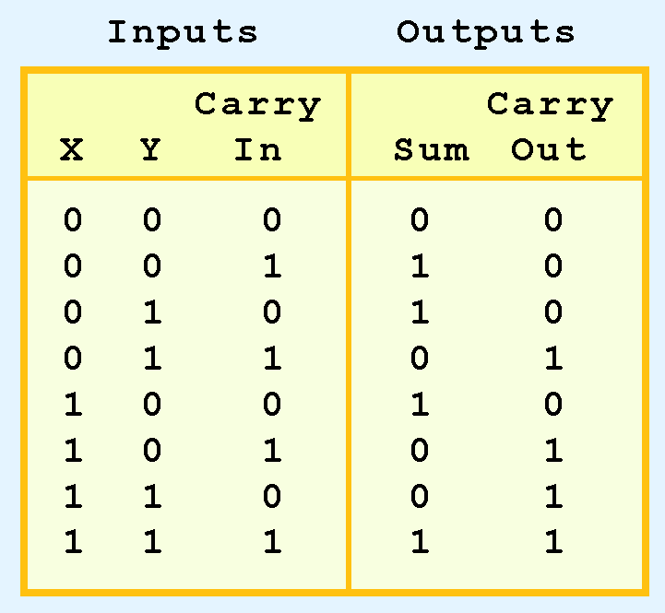
Two half adders combined for a full adder (A circuit to add two operand bits and a carry bit, the way we did before.)
17
17

Slide 18
CPU Multi-bit Adders
The multi-bit adders in real CPUs use one of the full-adders on the previous slide for each “column” of a multi-bit addition (carry-in and two operand bit inputs; sum and carry-out outputs).
So, a 64-bit adder would have 64 of the full adders on the previous slide; the carry-out output from each full adder is fed to the carry-in input of the full-adder for the next most significant full adder (the next "column") of the addition.

Slide 19
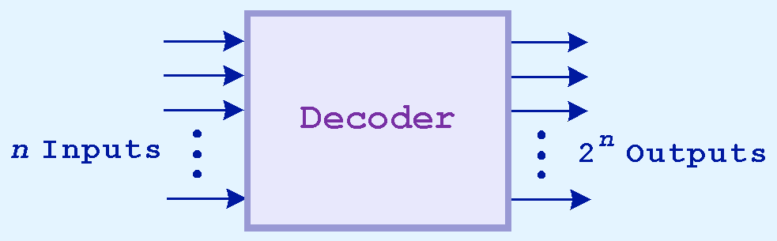
Decoders
Used, e.g., to select a memory byte, given the address of the byte
For each combination of n input bit values, one of the n outputs is “selected” (is 1/on/true); all other outputs are not selected (are 0/off/false)
The selected output is used to access (read or write) the appropriate byte in memory.
Address decoder with n inputs can select any one of 2^{n} bytes of memory

Slide 20
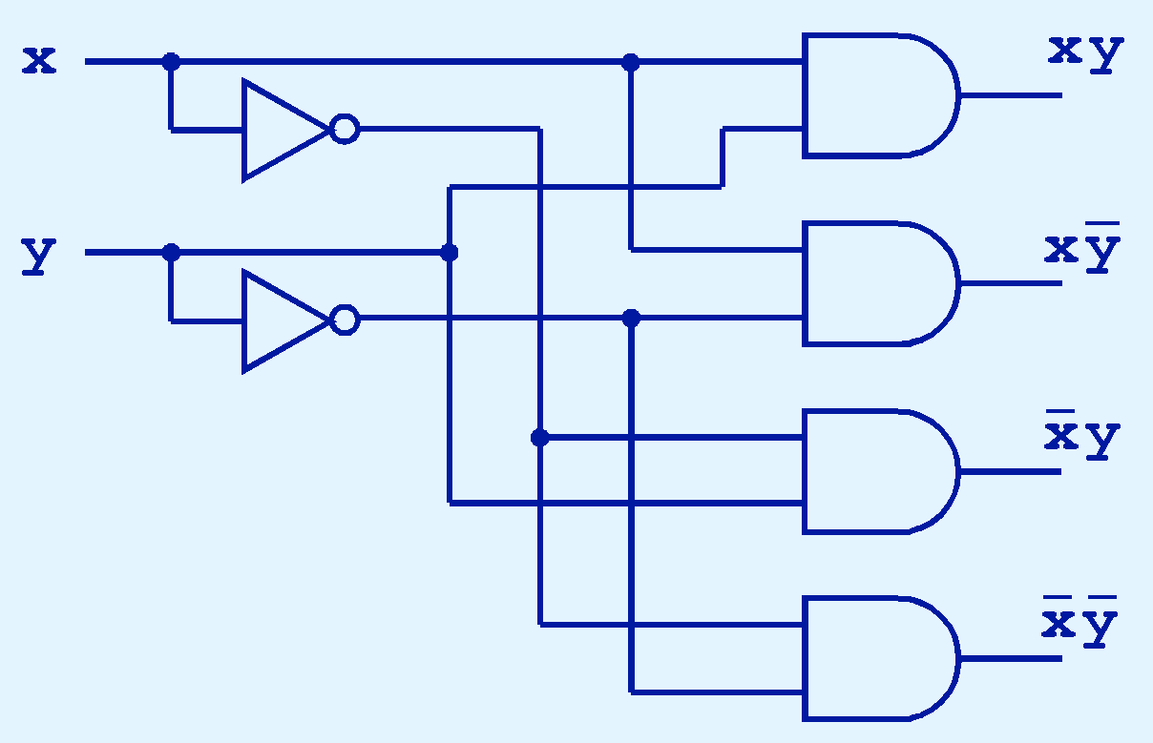
2-to-4 decoder
This decoder can be used for a machine with 4 bytes (!) of memory with 2-bit address:

Slide 21
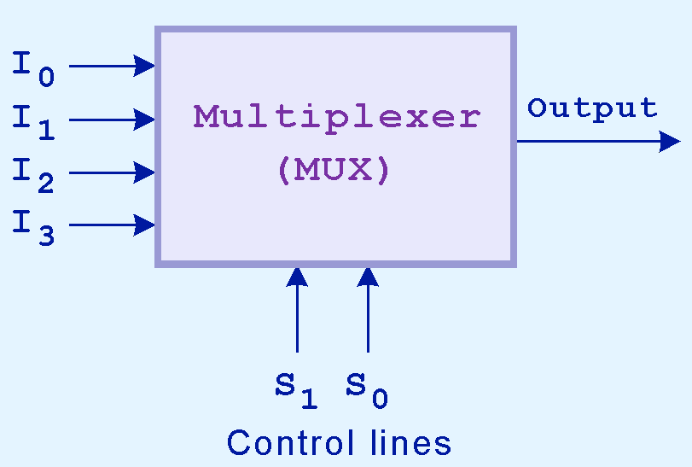
Multiplexor: "reverse" of a decoder
Selects a single output from several inputs (the bit value on the input selected will be passed to the output).
The one chosen is determined by the value of the multiplexer’s control lines.
To select among n inputs, log₂n control lines are needed. NOTE:
log2n is the power to which 2
must be raised to get n.

Slide 22
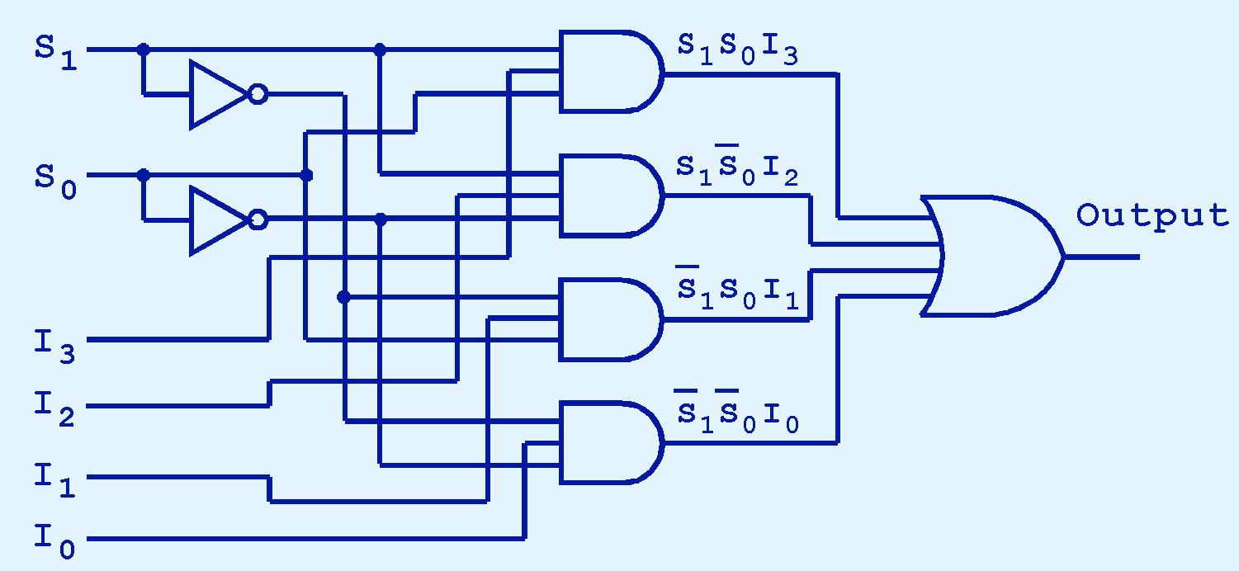
4-to-1 multiplexor
If S₀ = 1 and S₁ = 0, which input is transferred to the output?
The OR gate at the end can become huge (many inputs)
Solution (in some situations): Tri-state devices
Data In
Control Data In Data Out
0 0 --
0 1 --
1 0 0
1 1 1
Data Out
Control

Slide 23
Combinational vs. sequential circuits
A combinational circuit has no “memory”; i.e., the value(s) on its output port(s) depend(s) only on the current values on its input port(s); no dependence on history (prior inputs)
The value on the output port(s) of a sequential circuit though, will, in general, depend on the current values on its input port(s) as well as on past values (so these circuits have “memory”)
Our circuits so far have been combinational but both kinds are very important in systems

Slide 24
Combinational and sequential uses
Combinational circuits are used to implement operations in ALU units (addition/subtraction, multiplication, division, AND, OR, XOR, etc.) in a CPU (and for other purposes also, such as decoders and multiplexors).
Sequential circuits are used for all forms of memory (registers, cache, main memory (RAM), and even digital disk drives (SSDs) [but NOT for traditional hard-drives (magnetic disks)]

Slide 25
Reminder about NOR gates
The sequential (memory) circuit on the following slide uses NOR gates.
Let’s remember that a NOR gate has the inverted output of an OR gate for the same inputs (because the output of the OR gate is inverted (fed to a NOT gate) to get the output of the NOR gate.
Remember OR: If one or both inputs are 1, the output will be 1; otherwise, the output will be 0.
SO: For a NOR gate, if ANY INPUT (one or both) is/are 1, the output will be 0; otherwise (both/all inputs are 0), the output will be 1. That is, a NOR gate outputs 1 IF AND ONLY IF neither input is 1; if at least one input is 1, it outputs 0.

Slide 26
Basic seq. circuits
S | R | Q_{a} | Q_{b}
0 | 0 | 0/1 | 1/0
0 | 1 | 0 | 1
1 | 0 | 1 | 0
1 | 1 | ? | ?
(no change)
R
Q_{a}
G_{a}
Q_{b}
R=1, S=1 is not used
The SR-gate remembers which of S, R was mostly recently 1
Q_{b} is often denoted as Q_{a} but it is not really a complement
G_{b}
S
Suppose R=1 and S=0; then Q_{a} =0 and Q_{b}=1 and they will not change if R becomes 0
If R=0 and S=1; then Q_{a}=1 and Q_{b}=0 and they will not change if S becomes 0
Thus S is “set” and R is “reset”
If R and S are both 1 then if both change to 0 (at about the same time), the values of Qa and Qb are unpredictable (those are the ? values in the table)

Slide 27
Timed sequential circuits
R
R’
Q
clock
Q
S’
S
Clk | S | R | Q(t+1)
0 | x | x | Q(t)
1 | 0 | 0 | Q(t)
1 | 0 | 1 | 0
1 | 1 | 0 | 1
1 | 1 | 1 | ??
(no change)
S
Q
(no change)
Clk
R
Q

Slide 28
Timed sequential circuits
Two problems:
(1) S, R both being 1
Solution: use NOT S as input to R (so S is really the only input, since R is just NOT S)). With this change, slide 27 above is a D flip-flop (S is D, and R is NOT D).
(2) S/R changing when clock signal is 1
Solution: wait enough time for S/R to stabilize before clock goes to 1 (do not make clock too fast)
D
Q
D | Q(t+1)
0 | 0
1 | 1
C
Q

Slide 29
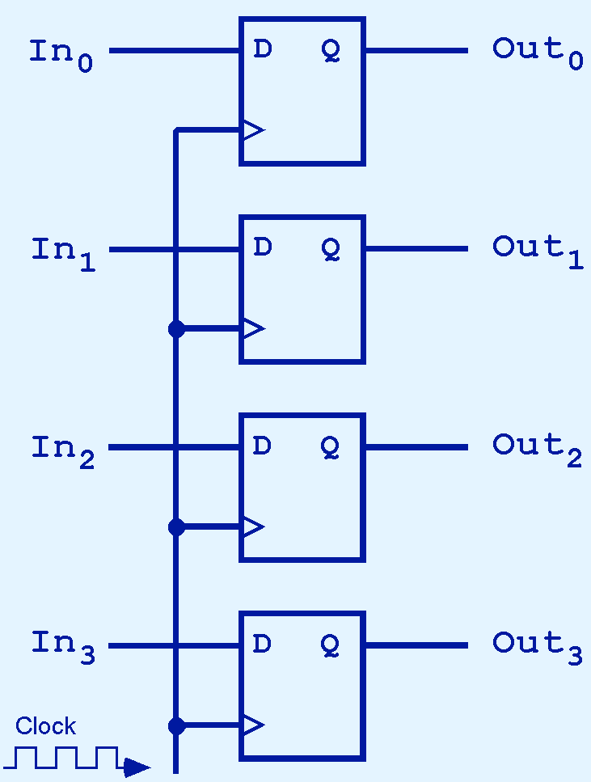
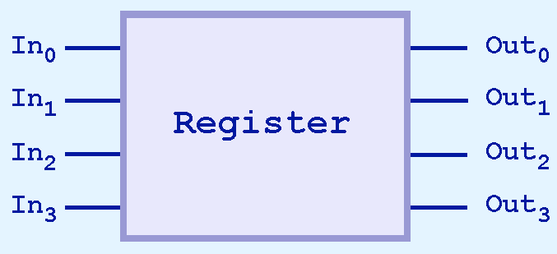
A 4-bit register (using 4 D flip-flops)
Current value in the register is always available at the output
Values on the input lines appears on the output lines at the next clock cycle
More precisely, when there is a 1 input in the second input port (the clock), the value that is on the first input port goes into the D flip-flop and is the new value that will appear on the output lines
The clock signal can be AND-ed with register address to decide whether this value is intended for this register

Slide 30
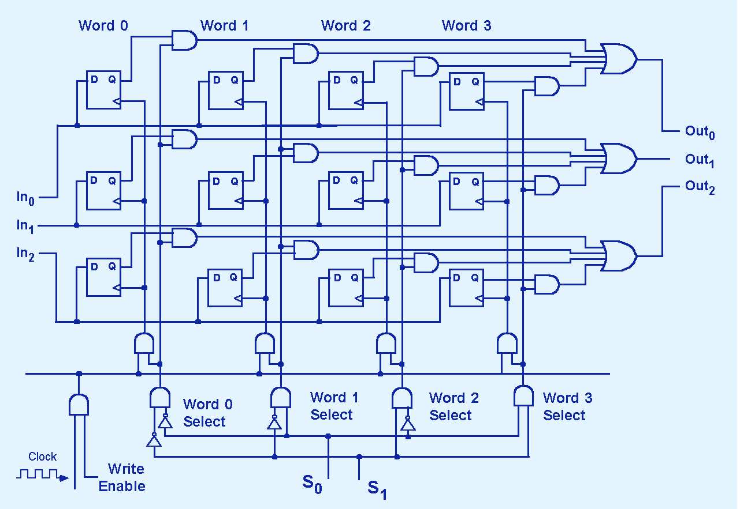
4-word, 3-bit memory with addresses 00, 01, 10, 11 on lines S0, S1
“Write Enable” tells us if we want to write a new value into particular word
“AND” the address with the clock signal and “Write Enable” and feed it to the “clock port” of each D flip flop of the register.
Also use S0,S1 to decide which value appears on Out-lines
Tri-state devices used to eliminate the (HUGE) OR gates on the output side

Slide 31
(Brief) Summary of some key points
Boolean functions are described by truth tables.
Logic gates implement Boolean operators.
The basic gates: AND, OR, and NOT.
Other imp. gates: XOR, NOR, NAND
NOR, and NAND are universal gates

Slide 32
Summary (contd)
Both combinational circuits & sequential circuits are essential in systems.
Combinational circuits produce outputs (almost) immediately when their inputs change.
Sequential circuits require clocks to control their changes of state; sequential circuits are the basis of all types of memory.

Slide 33
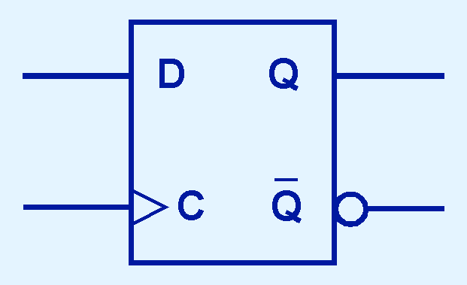
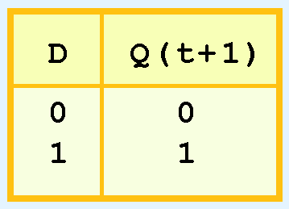
Many basic sequential circuits …
D-flip-flop: Output changes only when the value of D changes: this is what is used for implementing memory
But remember: the change happens at the next clock cycle; that is what Q(t+1) means

Slide 34
Summary (contd)
Basic sequential circuit: flip-flop
Basic flip-flop to store a bit: D flip-flop
Sequential circuits, especially D flip-flops, are the basis of memory
But accessing memory requires combinational circuits as well (decoders and multiplexors)
Calculations (e.g., in an ALU) are done using combinational circuits

